Slide 1
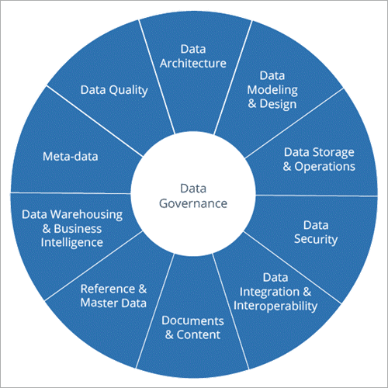
What is Data Governance ?
Data governance is a system for defining who within an organization has authority and control over data assets and how those data assets may be used.
It encompasses the people, processes, and technologies required to manage and protect data assets.
Data governance is the practice of managing and organizing data and processes to enable collaboration and compliant access to data.

Slide 2
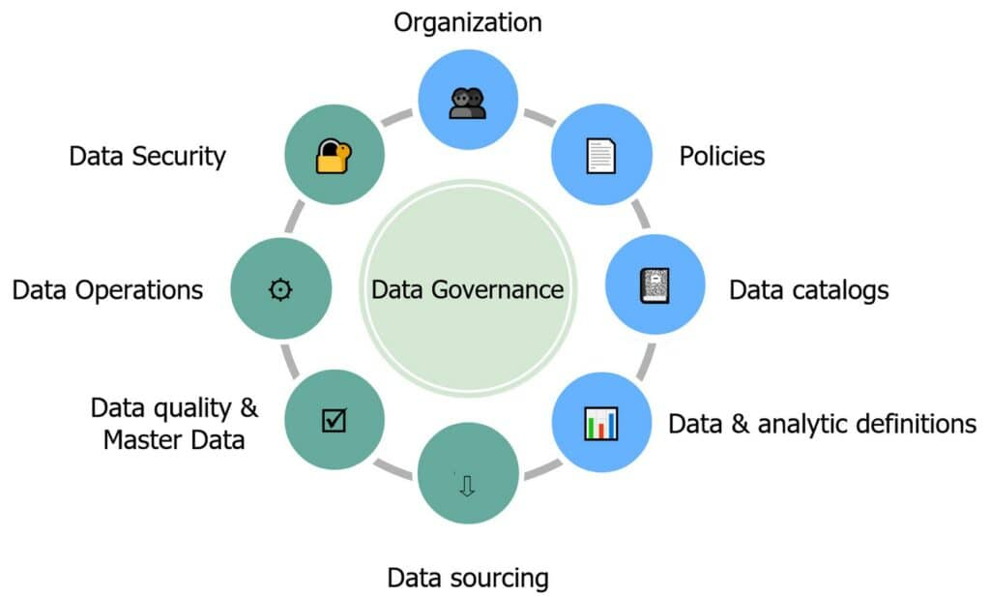
Why Data Governance ?
Data governance helps to ensure that data is usable, accessible and protected. ... At its core, data governance leads to improved data quality, decreased data management costs, and increased access to data for all stakeholders. The result is better decision making and better business outcomes.
Data Governance is required when
the size of the organization or the complexity of technology outgrows the ability to manage it,
you need to break down data silos and organizational barriers,
and when regulation, compliance, or contractual requirements require Data Governance.
You are making bad decisions because of bad information.
You miss opportunities because it takes too long to get the information you need.
Your competitors are beating you because you can’t react fast enough.
You can’t trust your data.
Analysts spend more time preparing and cleaning data than using it.
Managing data costs more than it should because you have to spend so much to correct it.

Slide 3
How to evaluate Data Governance Tool ?
Profiling of Various Data Sources:
Data Quality Scorecard
Problem Logging and Data Alerts
Data Problem Resolution Process
Support for Internal/External Audits
Data Governance KPIs
managed metadata environment
Data is the greatest asset of our companies. You have to manage it or, like to say, “goal manage it,” so if you have not yet decided on a DG tool, it’s time to look for one
Here are the Steps how we can approach to find the right tool
Multi-Tenancy:
Cloud Deployment
Licensed or Open Source
Open System or Closed Ecosystem
Usability of the Business Glossary
Custom Attribute
Personalized Relationships
Data Management:
Customized Roles
Authorization Workflows
Master Data Rule
Data Lineage
Impact Analysis
Hierarchy of Data Artifacts
“A Metadata Management system must be able to extract metadata from many sources. Design the architecture to be able to scan the various sources of metadata and periodically update the repository. The system must support manual metadata updates, requests, searches, and metadata lookups by various user groups.”
From DAMA- DMBok2

Slide 4
Steps for Effective Data Governance
Ensure information integrity.
Create roles, responsibilities, and rules.
Convert to a master data–based culture.
Maximize information availability.
Develop a feedback mechanism for process improvement.
Prioritize areas for improvement.
Data governance connects business strategy with information policy.
it’s about defining, implementing, and enforcing formal policies and processes for how information is generated, stored, used, and maintained across a business.
Effective data governance enables organizations to rationalize information from countless systems and achieve a set of consistent, coherent views of the enterprise.

Slide 5
Components of data Governance
Create a unified view of all data assets
Empower your organization with data
Trust the data you use for analysis
Focus on delivering business insights
Business Glossary
Data Dictionary
Policy Manager
Reference Data
Data Catalog
Data Governance
Data Privacy
Data Lineage
Accelerate privacy operations with the data
Collaborate on a single platform across teams
Operationalize policies in a central location
Better understand your data
Conduct impact analysis
Help comply with regulations

Slide 6
Data Governance Roles
Chief Data Officer
Data Owners
Data Governance Committees
Data Stewards/Custodians
Chief Data Officer
Chief Data Officers (CDO) are a fast-growing job over the last few years. Companies are beginning to understand the importance of managing data and implementing a data governance framework, and that means hiring a CDO. The CDO is the company leader of the data governance strategy, and hiring a CDO shows the commitment to data and buy-in from the top to take a data governance program seriously.
Data Owners
Data Owners are the people that have direct responsibility for data. They are involved in the protection and quality of data as a business asset. A data owner will be on the team that uses the data. For example, a member of the finance team should be a Data Owner for the Finance team’s data.
Varonis automates the process for Data Owners to manage access to their data. Data Owners know who in their organization should have access to their data, and providing them the tools they need to manage and audit access to data is good data governance.
Data Stewards
Data Stewards are the champions of your data governance strategy. They meet with Data Owners and enforce data governance policies and procedures, as well as train new data owners and employees in data governance.
Data Governance Committees
The Data Governance Committee sets policies and procedures for data governance. This committee works with the CDO to establish the who, what, when, where, and why of data governance.

Slide 7
Data Governance Strategies
Data
Systems
Processes
Users
Costs
Benefits
Data: Raw or processed data of any type (financial, numeric, image, text, etc.) relevant to the Application Area. These should be identified regardless of where they originate.
Systems: Hardware, software, & telecom systems that are used to collect, organize, & process data (regardless of whether they are inside or outside the organization).
Processes: Manual and automated tasks associated with managing & using data – remember, this is not just about software!
Users: Individuals & groups that analyse, consume, or apply data supplied by systems & processes.
Costs: Direct & indirect cost of resources required to provide data to users.
Benefits: Measures of the value derived from using or analysing the data.
Value and Outcomes
Transparency and Ethics
Risk and Security
Trust
Accountability and Decision Rights
Education and Training
Collaboration and Culture

Slide 8
Data Governance Best Practices
Set format standards for your data
Keep it simple!
Unmanaged data is still data!
Map your business goals
Establish roles for members of your data.
Measure your progress in several different ways.
Automate as much as possible
Classify and Tag all of your data
Operation Model Definition
Data Governance Workflow
Providing Incentive for Compliances
Adhering to laws and regulations
Stockholders and data domain identification
Involvement of all leadership in data governance

Slide 9
Tools/Softwares
Data Governance Tools | Features & Functions | Platform | Price
OvalEdge | Data Governance, Data Catalog, Automated Data Lineage, Data Discovery, Self-Service Analytics | Windows, Unix, Cloud, On-Premise, Web, and SaaS. | Starts at $50/user/month. For more details, contact company.
Truedat | Data Governance, Business Glossary, Data Catalog ,Data Lineage, Data Quality. | Cloud, On-Premise. | Open source. Professional Services Fee. Contact the company, for more details.
Xplenty | Data Integration, ETL, ELT, etc. | Windows & Mac. | Get a quote.
Atlan | Data Governance, Automated Lineage, Auto-Classification of PII, Column Level Access Control, Cloud Integrations. | Web, Cloud, and SaaS. | Pay as you go pricing. Get a quote.
Collibra | Collaboration Features, Data Help Desk, Automation of Data Governance & Management. | Windows, Mac,iOS, Cloud, Web, and SaaS. | Contact company.
Tokern | Tokern is an open source data governance suite for databases and data lakes. Improve ROI of your data, comply with regulations like HIPAA, CCPA and GDPR and protect critical data from insider threats with confidence. | https://tokern.io/docs/ | https://tokern.io/docs/
Apache Atlas | atlas.apache.org | Linux ,Mac | Open Source

Slide 10
Build Vs Buy
Exploration and Understanding
Metrics
Trust
Operations
Operational Metrics
Scorecard
Access control
# of rows
Quality score
Last updated
Data source completeness
Value of data
Completeness
Timeliness
Scale and ingestion
Security
Governance
Attestation
Steward field
Workflow
Broadening the understanding of security and access to data
Profiling SQL queries to identify joins
Google like search
Restricted views
Data Enrichment
Metadata in Place – get metadata from anywhere…not just from within the tool
Increase personalization
Data Catalog – additional content, like statistics
Cloud / IOT integration
Cost / Eliminate redundancy
Redundancy detection
Impact analysis for lineage (gremlin)
Linage profiler/analyzer (dead ends CV)
Reference data management
Decommissioning/tagging of asset
Machine Learning and Analytics
Current ML capabilities, Classification and Binding
ML to alert about new/relevant data
Analytics of data
Metadata extraction from unstructured data

Slide 11
Data Governance Challenges
Data governance is a part of a larger IT Governance policies. The two initiatives need to work in concert with each other for both to be successful.
Change of any kind is hard, but getting employees to care about data governance is especially difficult. Users need incentives and motivation to follow your new data governance initiatives.
Data governance efforts need to be flexible to team needs and simple for users. If data governance impedes work efforts, it will not promote business goals.
Selecting technology and tools to manage a data governance strategy can be complicated. Use resources like Gartner to research technology and request references for systems that fit your strategy.

